Slide 1

KING COUNTY HOUSING (REGRESSION)
ANN MAUREEN WANGUI NGINA

Slide 2
Overview of the dataset
The American state of Washington is where King County is situated. According to the 2020 census, there were 2,269,675 residents, ranking it as the 13th most populous county in the US and the most populous county in Washington.
King County has a relatively wide wealth disparity, both within the county and in relation to state and national averages, which is one of the dataset's most notable findings. Even though some of the wealthiest people in the world dwell there, 10% of the county's population lives in poverty.
King County includes Seattle, where the average household income is $89,675, which is 49 percent higher than the national average. Perhaps one of the contributing factors to the region's rapid growth in technology

Slide 3
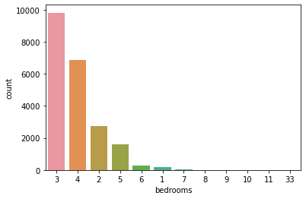
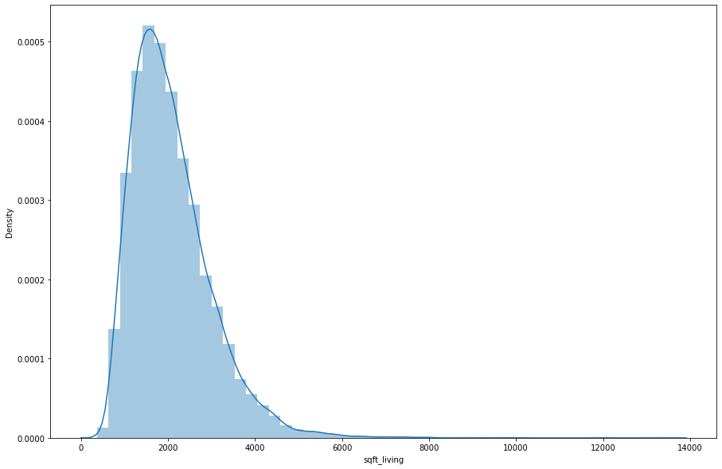
DISTRIBUTION OF VARIOUS VARIABLES
The graph shows the distribution of the number of bedrooms in the different houses in the dataset.
The graph shows the distribution of space in the various houses in the dataset, which is skewed.

Slide 4
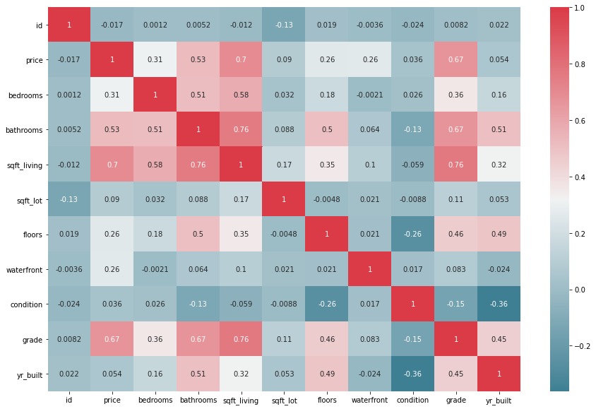
Correlation Matrix We now get to see the correlation of the various variables in the dataset. It is evident that we have a high correlation on certain variables such as (sqft_living and grade)

Slide 5
findings
The coefficient of all the attributes shows how each attribute affects a home's price. In other words, the sqft living value for the size of the house was 291.7931, which means that the price of the home will increase by 291.7 dollars for every additional square foot of living space. However, the sqft_lot showed a negative correlation to the cost of the house. Given that the pvalue of the id column has shown that it is not important.
The number of bedrooms was negatively correlated with the home's price.
If a house has additional bathrooms, floors, a beachfront, and other desirable features, its overall price will go up. If the residence has waterfront, the price will rise by 816800.

Slide 6
RECOMMENDATIONS
Our algorithm offers the seller some recommendations on how to raise the potential selling price. For instance, they could try to renovate the home, add a water front if they can, and increase the number of floors and bathrooms.

